Slide 1


GROUPID_17

Slide 2


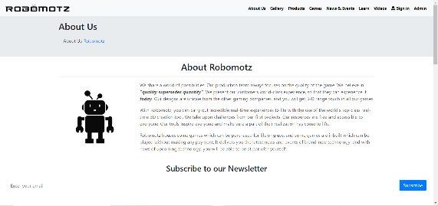
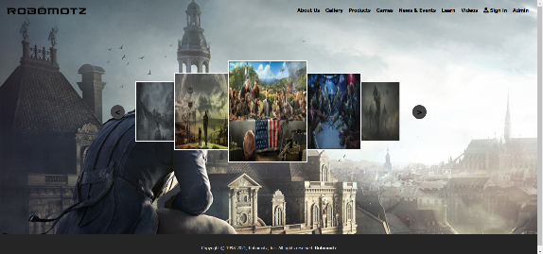
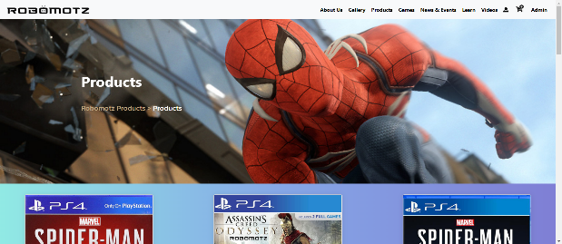

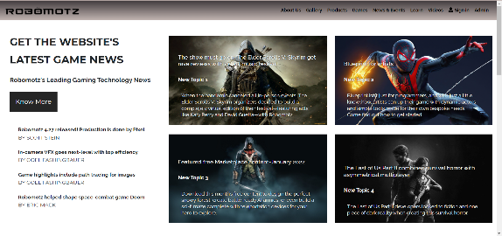
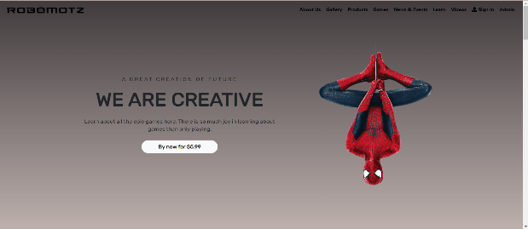
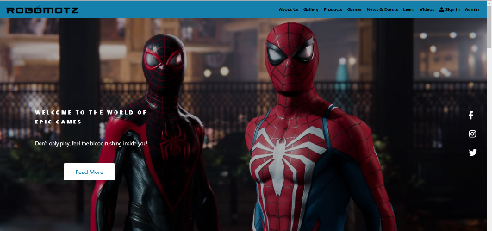
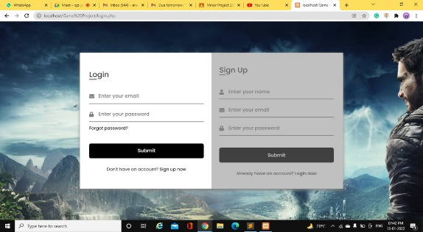
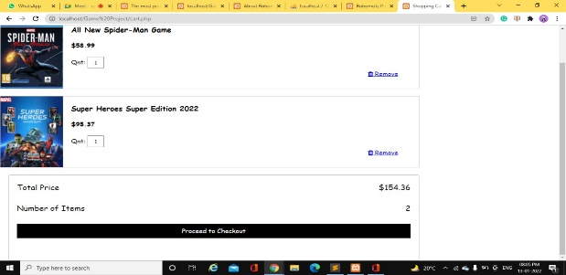
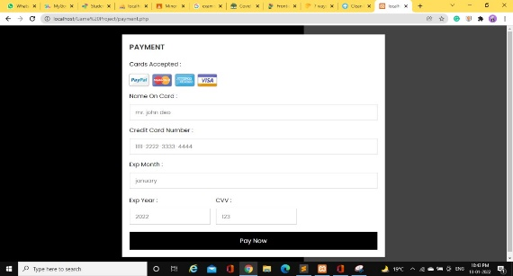
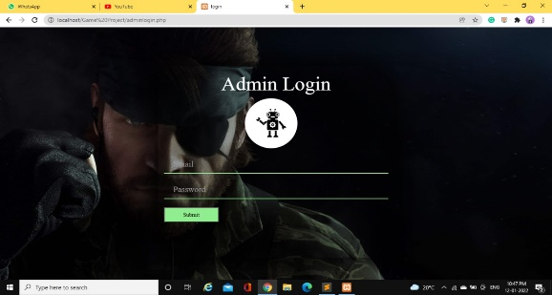
Robomotz presents you with an extraordinary gaming website. From teaser videos to upcoming game launches, everything will be available to you inside this website. Our production team always focuses on the quality of the game. We believe in “quality supersedes quantity”. With Robomotz, you an carry out incredible real-time experiences to life with the use of the world’s top-class real-time 3D creation tool. It also houses some games which can be purchased for lifelong use, and some games are inbuilt which can be played without making any payment. Explore, have fun and indulge in adventure here right now!
GROUPID_17

Slide 3


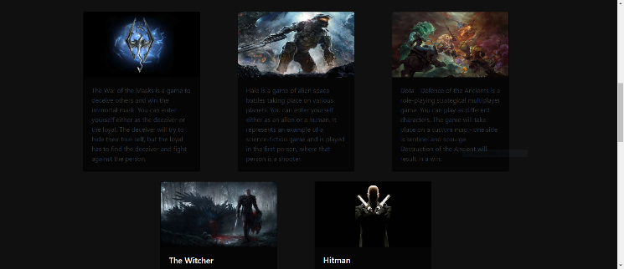
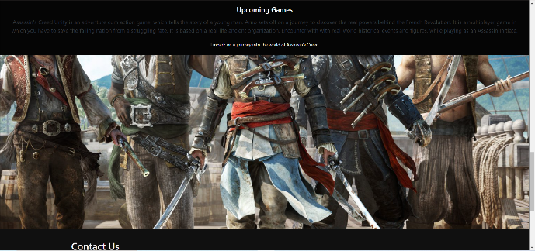
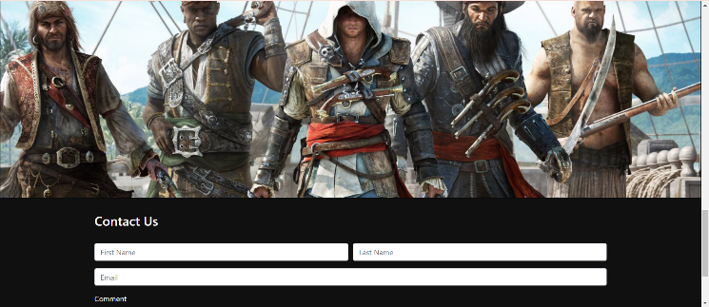
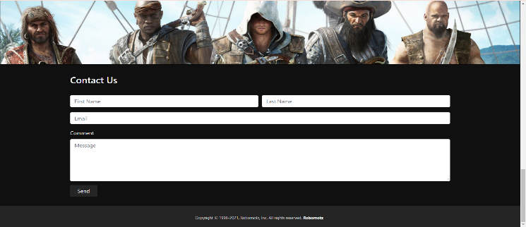
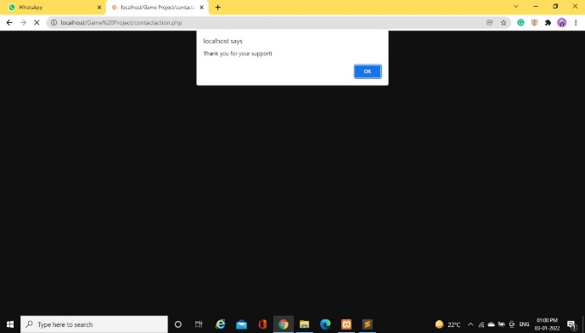
Home
The home page of Robomotz describes about the company website and contains few internal links. Also, it has a ‘Contact Us’ section which cannot be accessed without signing in for unregistered users and without logging in for registered users.
GROUPID_17

Slide 4
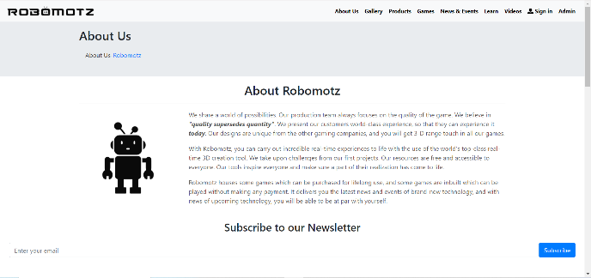
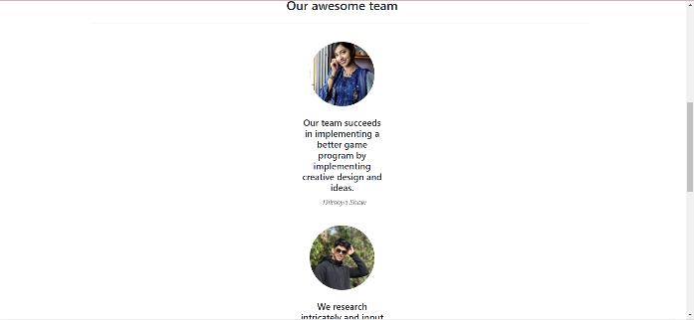


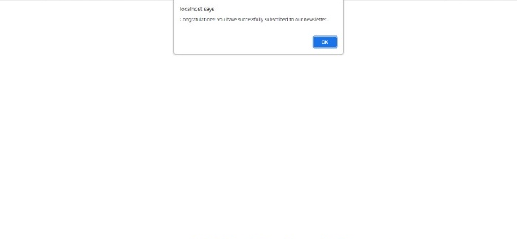
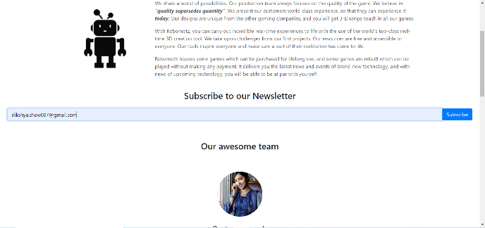
About Us
The ‘About Us’ page of Robomotz has a little section which talks about the company’s aim. Moreover, it has a ‘Subscribe to our Newsletter’ section and a section about ‘Our awesome team’ which contains the team involved in the project work and a small line about their motto.
GROUPID_17

Slide 5

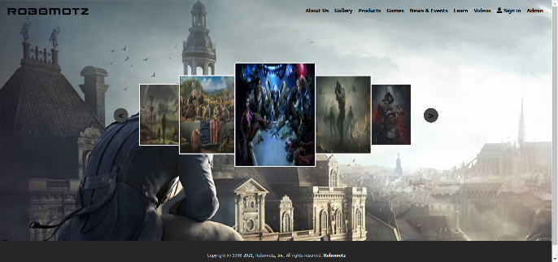
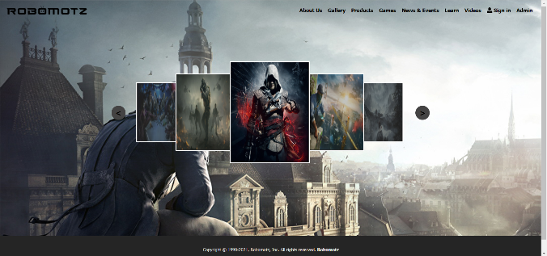
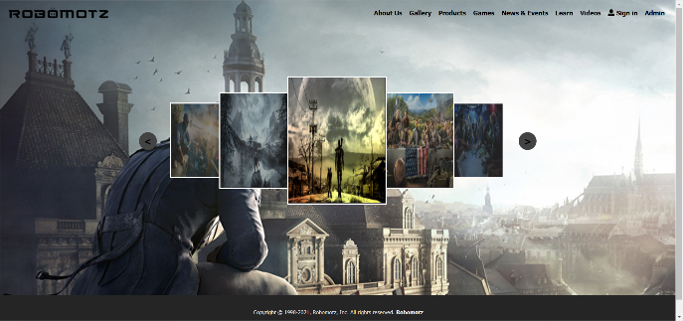
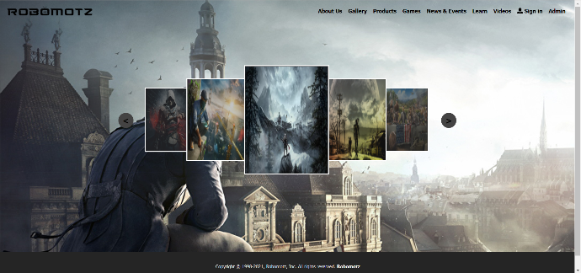
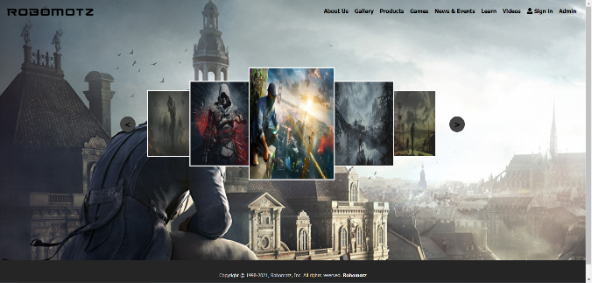
Gallery
The ‘Gallery’ page of Robomotz consists of an image slider where various pictures related to games are included. You can slide through the images and take the pleasure of seeing each and every picture included in the page. The page consists of total eight images.
GROUPID_17

Slide 6

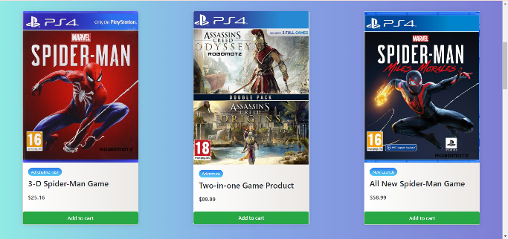
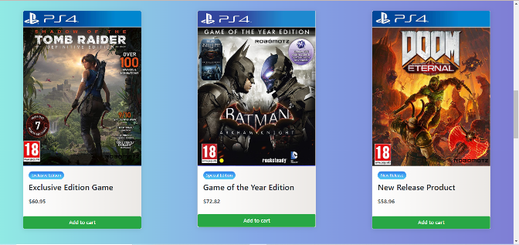
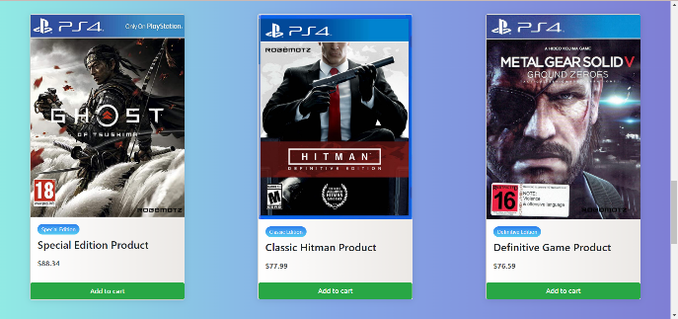
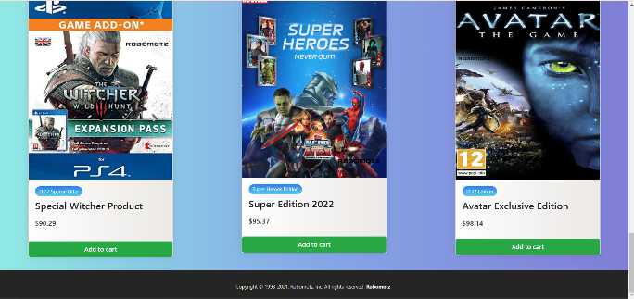
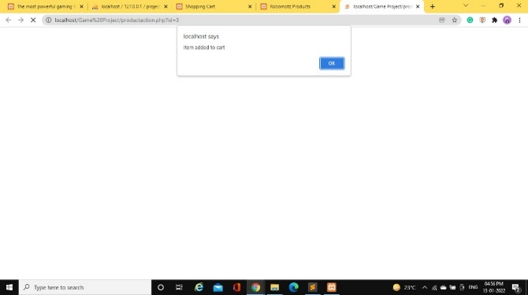
Products
The ‘Products’ page of Robomotz involves different products wherefrom users can explore and buy their choice of products. After selecting a product by clicking on ‘Add to cart’, the product will be saved inside the cart available in the navigation bar and from there, users will be directed to the shopping cart page.
GROUPID_17

Slide 7
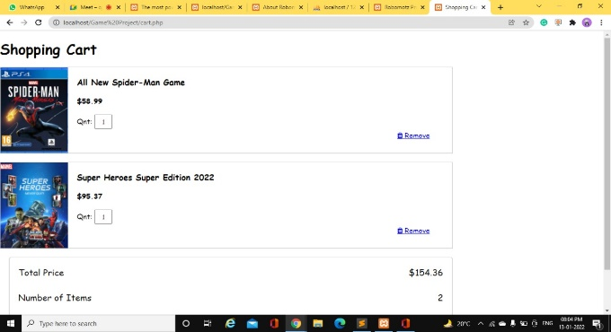

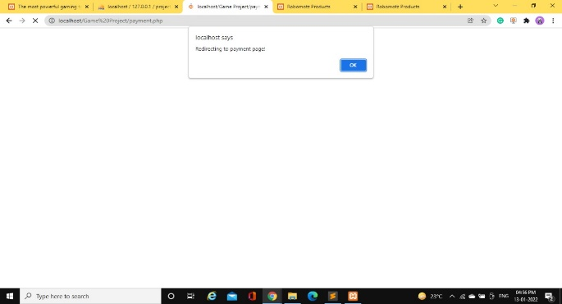
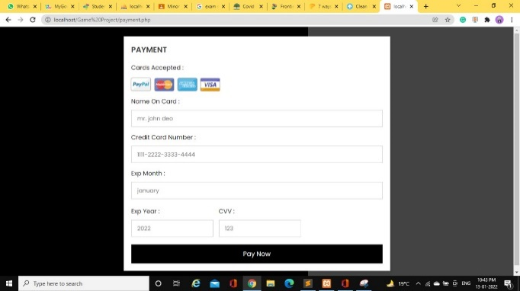
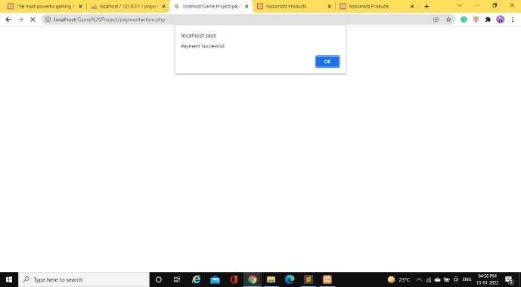
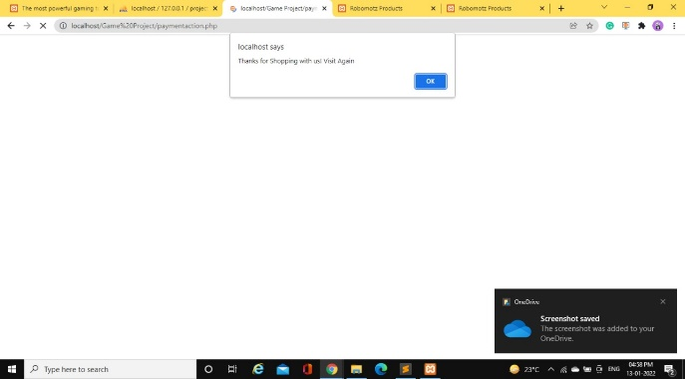
Shopping Cart & Payment Zone
By clicking on the cart option, a user will be directed to the ‘Shopping Cart’ page where the user can view all his products and click on ‘Proceed to Checkout’ to make payment. A form will be available asking for the user’s card details and rest. After clicking on ‘Pay Now’, the user will be redirected to home page.
GROUPID_17

Slide 8

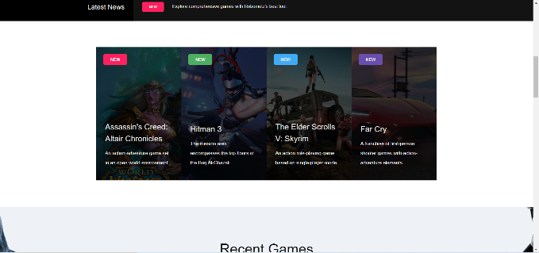
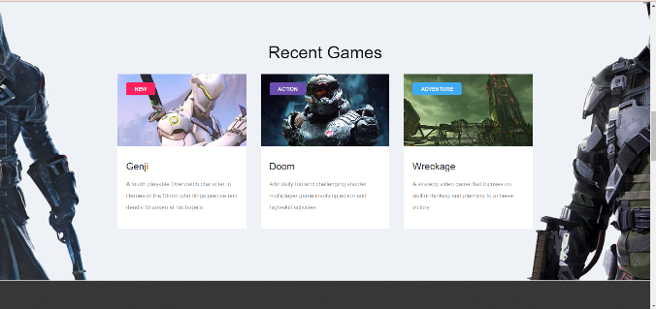
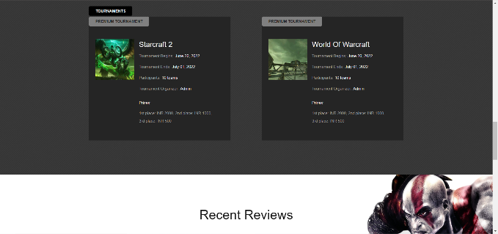
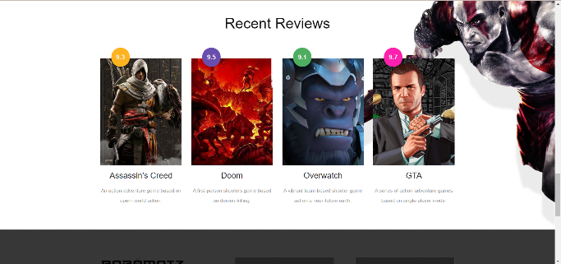
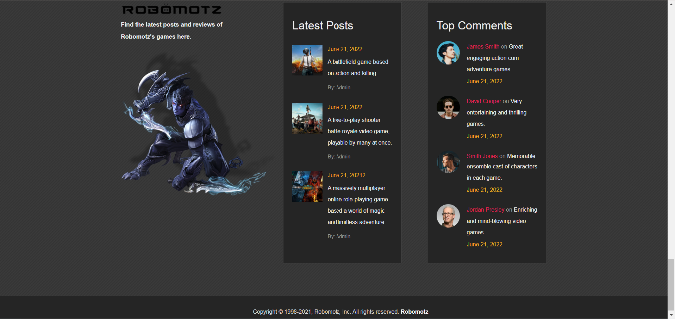
Games
The ‘Games’ page of Robomotz contains the best games out there and a vast description about various popular games. Some of the included sections are namely ‘Latest News’, ‘Recent Games’, ‘Tournaments’, ‘Recent Reviews’, ‘Latest Posts’ and ‘Top Comments’.
GROUPID_17

Slide 9
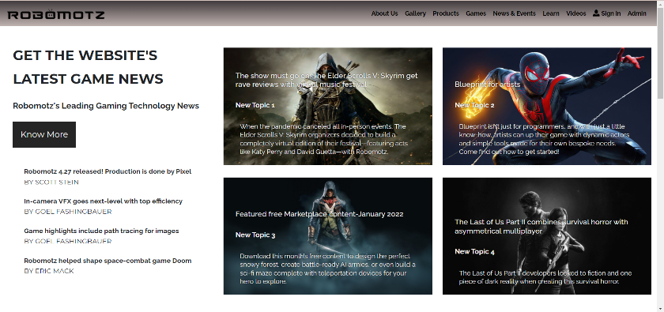
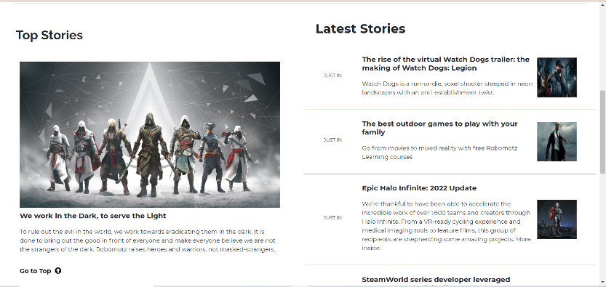
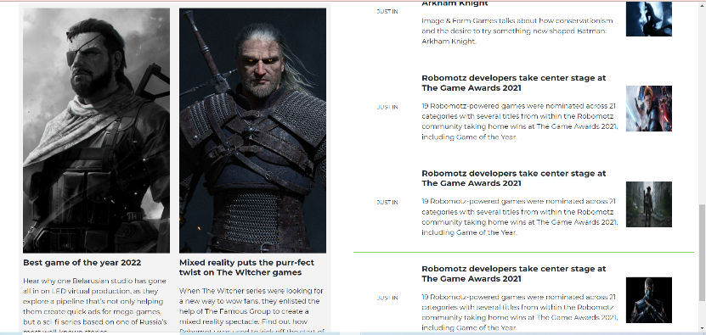
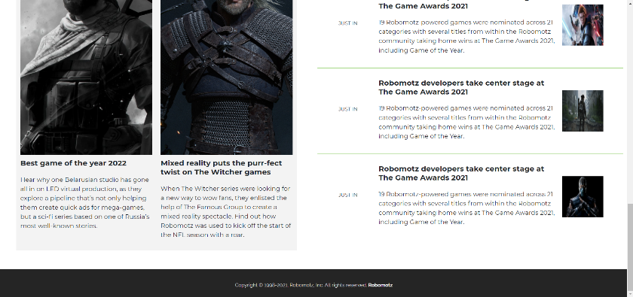
News & Events
The ‘News & Events’ page of Robomotz involves latest news and stories about the website’s games. ‘Latest Stories’ and ‘Top Stories’ are two famous sections of it.
GROUPID_17

Slide 10

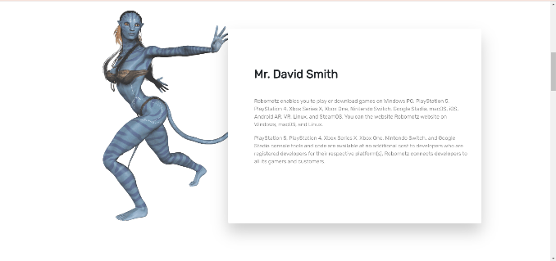

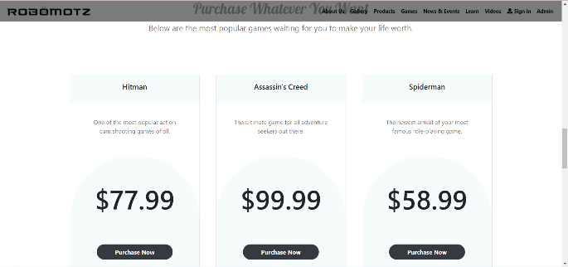
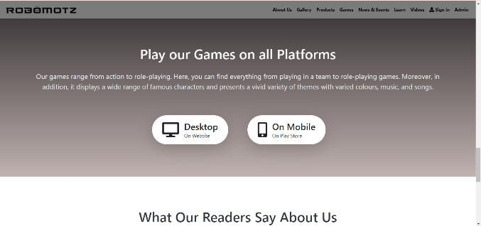
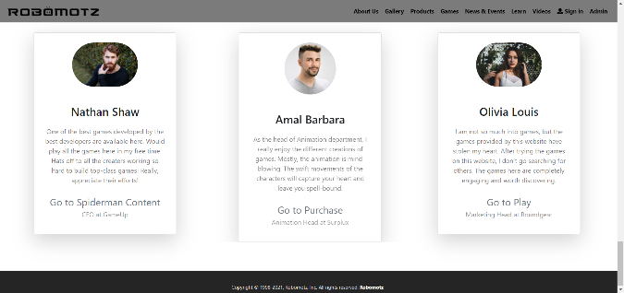
Learn
The ‘Learn’ page of Robomotz provides unique information about the website. Some of the included sections are namely ‘Some Features That Made Us Unique’, ‘Purchase Whatever You Want’, ‘Play our Games on all Platforms’ and ‘What Our Readers About Us’.
GROUPID_17

Slide 11

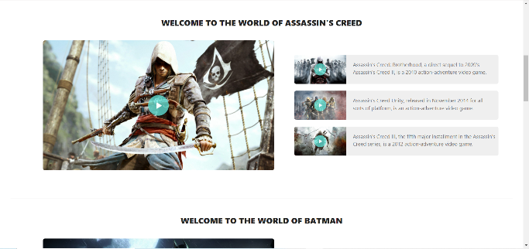
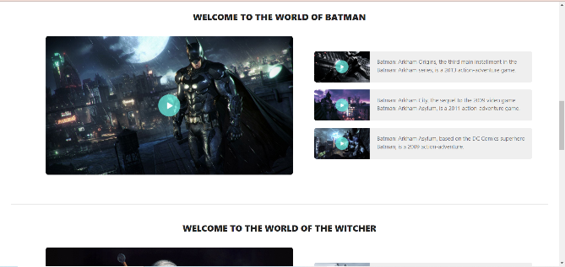
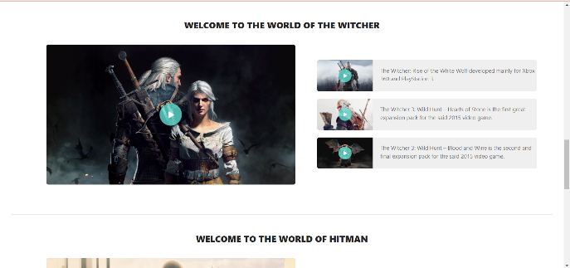


Videos
The ‘Videos’ page of Robomotz consists of several high-quality teaser trailers of several games. The rest of the page is divided in many smaller sections containing a combination of four games categorized to each section accompanied by a play and close button.
GROUPID_17

Slide 12




Sign in
The ‘Sign in’ page of Robomotz consists of two sections- Login and Sign up. A new user has to sign up to continue and an already registered user has to login to visit the website.
GROUPID_17

Slide 13






Admin
The ‘Admin’ page of Robomotz consists of four sections, namely ‘Dashboard’, ‘Product’, ‘Feedback’ and ‘Newsletter’. The admin page can be only accessed by the admin and on entering he/she has to provide their details. The page is connected and managed by PHP.
GROUPID_17

Slide 14




Dikshya Shaw
Aritra Dey
Anand Raj Keshari
Anisha Chatterjee
21301219038
21301219093
21301219035
21301219052
Our Awesome Team
Our team succeeds in implementing a better game program by implementing creative design and ideas. We research intricately and input images and videos which are unique to the world. Moreover, the motto of our team is to experience today and design tomorrow.
GROUPID_17

Slide 15
THANK YOU!
GROUPID_17

